Slide 1
Pointers and Arrays
1

Slide 2
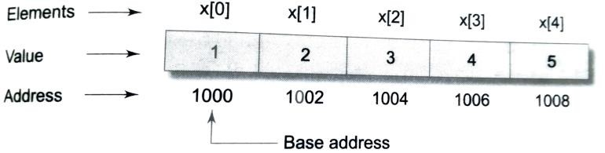
POINTERS AND ARRAYS
When an array is declared, the compiler allocates a base address and the sufficient memory storage to contain all the elements of the array in contagious memory locations
The compiler defines the array name as a constant pointer to the first element
int x[5] = {1,2,3,4,5};
Use pointer to point the array,
int* p;
p = x; or p = &x[0];
- increment the pointer to access the further locations, i.e. p++
2

Slide 3
ARRAY OF POINTERS
Address of an element can be calculated using its index and the scale of the data-type.
For example,
address of x[3]
= base address + (3 x scale factor of int)
= 1000 + (3 x 2)
= 1006
Using pointers, to access the elements in one-dimension array, use the expression: *(p+1).
To access the element x[3], we can use *(p+3)
To access array elements, one can use array indexing or pointers.
Pointer accessing method is much faster than array indexing.
3

Slide 4
ARRAY OF POINTERS
Example: 1
#include <stdio.h> const int MAX = 3;
int main ()
{
int var[] = {10, 100, 200};
int i, *ptr[MAX];
for ( i = 0; i < MAX; i++) { ptr[i] = &var[i];
}
for ( i = 0; i < MAX; i++) {
printf("Value of var[%d] = %d\n", i, *ptr[i] );
}
return 0;
}
Output
Value of var[0] = 10 Value of var[1] = 100 Value of var[2] = 200
4

Slide 5
ARRAY OF POINTERS
Example: 2
#include <stdio.h>
int main ()
{
int i, *p, sum;
int x[5] = {4, 6, 2, 8, 1}; i=0;
p=x;
printf("Element Value Address \n"); while(i<5)
{
printf("x[%d] %d %u \n",i,*p, p); sum = sum + *p;
i++; p++;
}
printf(“\nSum = %d", sum); return 0; }
Output
Element Value Address
x[0] | 4 | 3420677920
x[1] | 6 | 3420677924
x[2] | 2 | 3420677928
x[3] | 8 | 3420677932
x[4] Sum = 21 | 1 | 3420677936
5

Slide 6
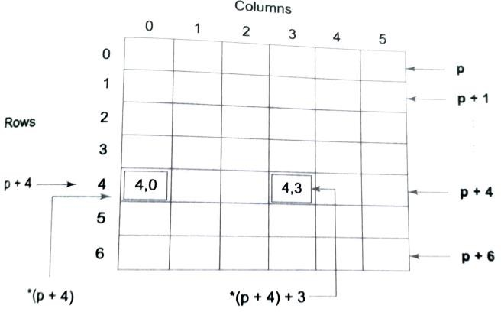
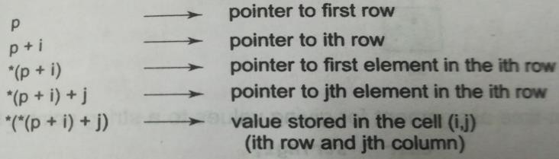
Two Dimensional Array Representation
An element in the two-dimensional array can be represented by the pointer expression as follows:
*(*(a+i)+j) or *(*(p+i)j)

Slide 7
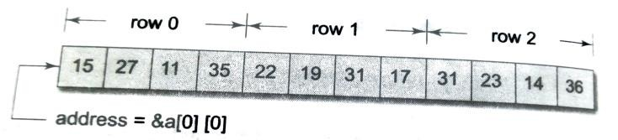
Two Dimensional Array Representation
Let us declare an array,
int a[3][4] = {{15,27,11,35},{22,19,31,17},{31,23,14,26}};
The compiler allocates contiguous space for all the elements row-wise.
i.e. the first element of the second row is placed immediately after the last element of the first row.
The elements of the ‘a’ will be stored as:
If we declare p as an int pointer with the initial address of &a[0][0], then a[i][j] is equivalent to *(p+ 4xi + j)
For example, the element a[2][3] is given by *(p+ 2x4 +3) = *(p+11)

Slide 8
Pointers and Character Strings
C supports a method to create strings using pointer variables of type ‘char’.
char *str = “good”;
This creates a string and stores the base address of string in the pointer variable. Pointer now points the first character of the string.
To print the content of the string,
print(“%s”, str); or puts(str);
Using pointers you can access the individual characters in a string.

Slide 9
Pointers and Character Strings
Write a C program using pointers to determine the length of a character string.
Program
#include <stdio.h> int main()
{
int length, i=0;
char *cptr = "VELLORE INSTITUTE"; printf("%s\n",cptr);
while(*cptr != '\0')
{
cptr++;
i++;
}
printf("\n Length of the string is %d",i-1); return 0;
}
Output
VELLORE INSTITUTE
Length of the string is 16

Slide 10
Array of Pointers
Consider a array of strings,
char name[3][25]; // allocate fixed storage of 75 bytes
Use pointer to a string so that optimal length can be allocated -> save lot of memory. For example,
char *name[3] = {“India”, “France”, ”Germany”};
// array of 3 pointers to characters
name[0] -> India name[1] -> France name[2] -> Germany
This declaration allocates only 21 bytes.

Slide 11
Array of Pointers
Example Program:
#include <stdio.h> int main()
{
char *name[3] = {“India”, “England”, “Wales”};
int i;
for(i=0;i<3;i++) printf("\n %s ",name[i]);
return 0;
}

Slide 12
Pointers as Function Arguments
The process of calling a function using pointers to pass the addresses of the variables is known as call by reference.
Example Program:
sample(int *p)
{
*p = *p + 10;
}
#include<stdio.h>
void sample();
int main()
{
int x=20; sample(&x); printf("%d", x); return 0;
}
// prints 30

Slide 13
Passing Pointers to a Function
Example Program:
#include <stdio.h>
void salaryhike(int *var, int b)
{
*var = *var+b;
}
OUTPUT
Enter the employee current salary:10000 Enter bonus:2000
Final salary: 12000
int main()
{
int salary=0, bonus=0;
printf("Enter the employee current salary:");
scanf("%d", &salary); printf("Enter bonus:"); scanf("%d", &bonus); salaryhike(&salary, bonus); printf("Final salary: %d", salary); return 0; }
13

Slide 14
Function returning Pointers
Sample Program
#include <stdio.h>
int *larger(int *, int *);
int main() { int a=10; int b=20; int *p;
p = larger(&a, &b); printf("%d",*p); return 0;
}
int *larger(int *x, int *y)
{
if(*x>*y)
return (x);
else
return (y);
}

Slide 15
Pointer to a Function
Functions are stored in memory as like data.
A function has a address, as like a variable.
The function name represents the address of that function – so you can assign a pointer
The declaration of a pointer to a function has the format: data_type (*function_name) (datatype 1..datatype n); Example: double (*sample) ();
Function call format:
(*function_name) (datatype 1..datatype n);
If you remove the parenthesis, it becomes function returning the pointer, i.e.
data_type *function_name (arguments);
Example: double *sample();

Slide 16
Pointer To A Function
Example Program 1
#include <stdio.h> int main()
{
int square(int); int (*ap)(int a); ap=square;
printf("Square of %d is %d",5,(*ap)(5)); return 0;
}
int square(int x)
{
return x*x;
}

Slide 17
Pointer To A Function
int square(int x)
{
return x*x;
}
Example Program 2
#include <stdio.h> int main()
{
int square(int); int cubic(int); int (*ap[2])(); ap[0] = square; ap[1] = cubic;
printf("Square of %d is %d",5,(*ap[0])(5)); printf("\nCubic value of %d is %d",5,(*ap[1])(5)); return 0;
}
int cubic(int x)
{
return x*x*x;
}

Slide 18

#include <stdio.h> int main () {
int var; int *ptr;
POINTER TO POINTER - the first pointer contains the address of the second pointer, which points to the location that contains the actual value as shown below.
Output
Value of var = 3000
Value available at *ptr = 3000
Value available at **pptr = 3000
int **pptr;
var = 3000; ptr = &var; pptr = &ptr;
printf("Value of var = %d\n", var ); printf("Value available at *ptr = %d\n", *ptr );
printf("Value available at **pptr = %d\n", **pptr); return 0;
}
18

Slide 19
Some example Pointer Expressions
Some example pointer expressions
y = *p1 + *p2;
Sum = sum + *p1; z = 5* - *p2/ *p1;
19

